Slide 1
“HOTEL BOOKING”
PRESENTED BY:
BASAVARAJ MATHAD

Slide 2
Objectives
The primary objective of this analysis is to investigate and understand the factors contributing to high cancellation rates at City Hotel and Resort Hotel. The goal is to derive actionable insights that can help in:
1) Identifying Patterns and Trends:
2) Identify and Analyze:
Determine the key factors contributing to high cancellation rates at City Hotel and Resort Hotel.
3) Evaluate Impact:
Assess how cancellations affect revenue and room utilization.
Provide Recommendations:
Offer actionable strategies to reduce cancellation rates and improve overall revenue and operational efficiency.

Slide 3
TOOLS/PLATFORMS FOR LANGUAGES TO BE USED
HARDWARE REQUIREMENTS:
Processor | Pentium 4 and above
RAM | 512 MB and above
Hard Disk | 40GB and above
SOFTWARE REQUIREMENTS:
1)Jupyter Notebook
2)Python
3) Pandas and numpy
4) Matplotlib
5) Seaborn

Slide 4
Buisness Questions
1)What is the distribution of reservation statuses (e.g., , canceled, not cancelled) across City Hotel and Resort Hotel
2) What is the average daily rate (ADR) for Resort Hotel compared to City Hotel?
3) What are the trends in reservation status (e.g., booking, cancellation) on a monthly basis for both City Hotel and Resort Hotel?
4) How does the average daily rate (ADR) fluctuate month by month for each hotel?
5)Top 10 countries with reservation cancelled?

Slide 5
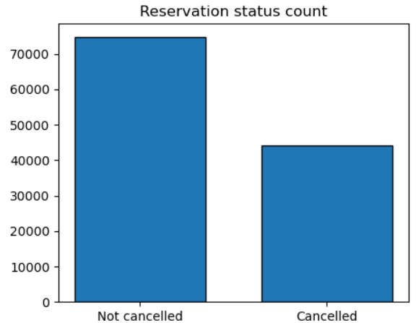
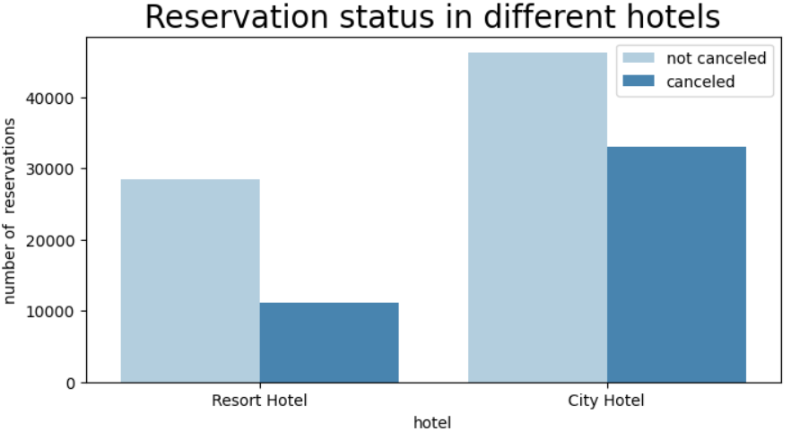
1)What is the distribution of reservation statuses (canceled, not cancelled) across City Hotel and Resort Hotel

Slide 6
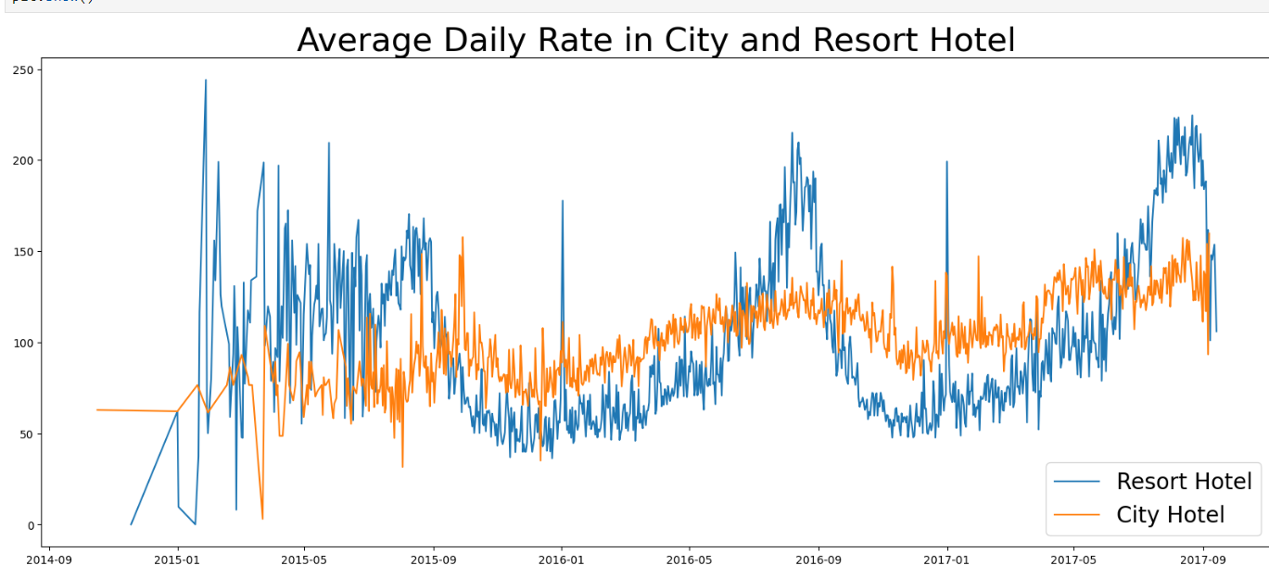
2) What is the average daily rate (ADR) for Resort Hotel compared to City Hotel?

Slide 7
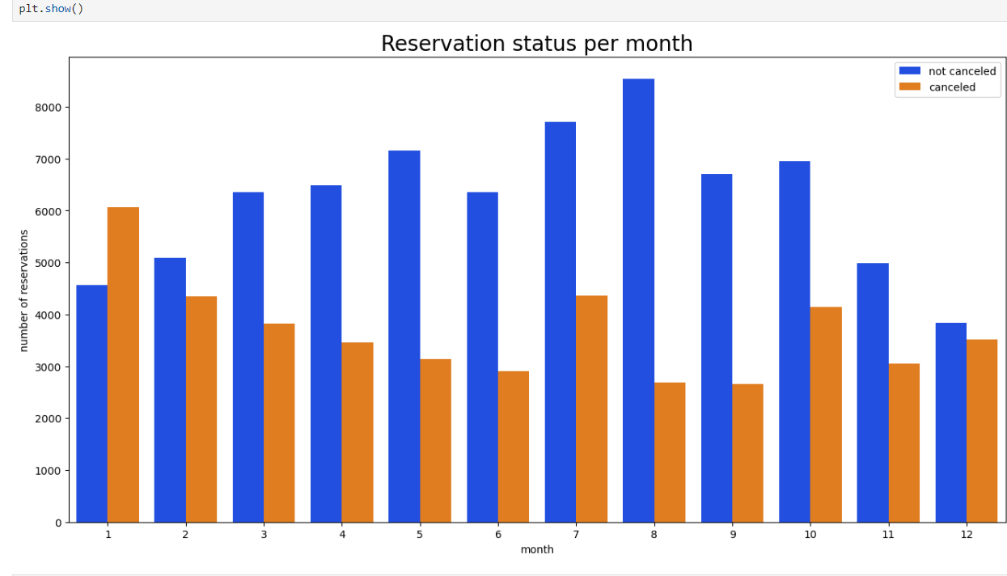
3) What are the trends in reservation status (e.g., booking, cancellation) on a monthly basis for both City Hotel and Resort Hotel?

Slide 8
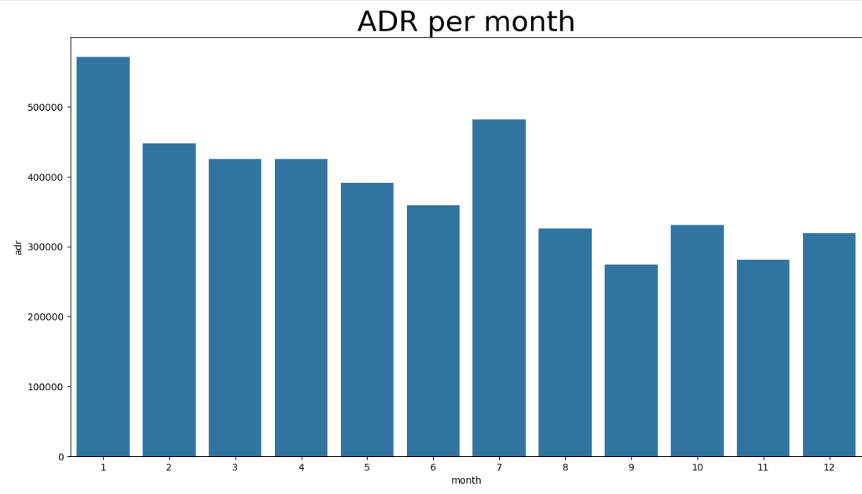
4) How does the average daily rate (ADR) fluctuate month by month for each hotel?

Slide 9
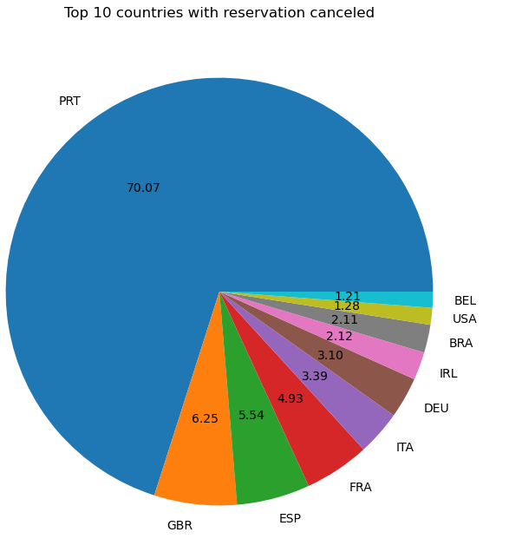
5)Top 10 countries with reservation cancelled?

Slide 10
Limitations :
Data Cleaning:
Handling and removing null values from the dataset.
Identifying and removing outliers to ensure data quality.
Data Visualization:
Challenges in effectively visualizing data using Seaborn, especially with complex datasets.

Slide 11
suggestions
Pricing Strategy:
To reduce cancellations, hotels should consider lowering room rates and offering discounts based on location.
Discounts for Resort Hotels:
Resort hotels should provide reasonable discounts on weekends or holidays to manage higher cancellation rates compared to city hotels.
Hotels should run marketing campaigns in January to boost bookings and counteract the high cancellation rates during this month.
Improve Hotel Quality:
Enhancing the quality of services, especially in Portugal, can help reduce cancellation rates.

Slide 12
Thank You

